Slide 1
Next-gen av vs my
$!#& code*
(*most of the code was stolen)

Slide 2

The “who am I” slide
James Williams
Pen Tester
Recovering .net developer

Slide 3
What’s coming up
Explanation / theory
Demos (lots of them)
Bad memes
Tool release

Slide 4
Demo time!
(Cylance - 32 bit)

Slide 5
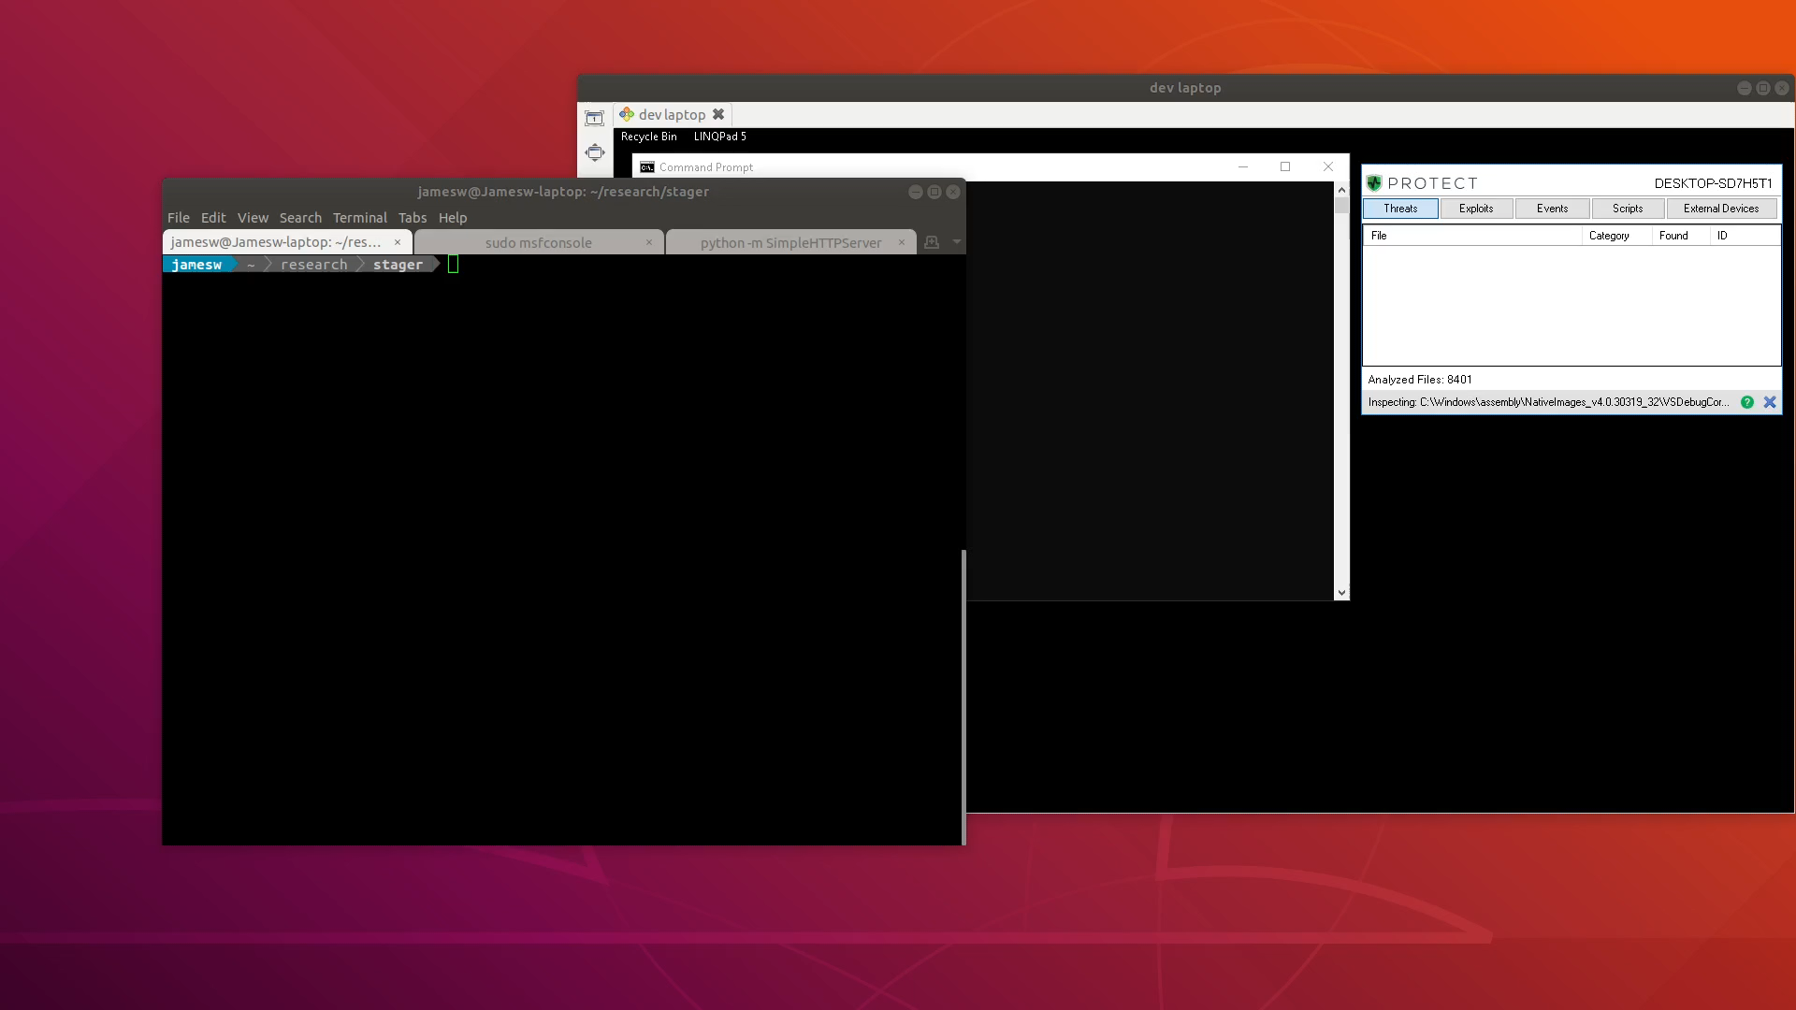
Demo time!
(Cylance - 32 bit)

Slide 6
What just happened?
The stage (UpdateService.exe) fetched an AES encrypted payload, built it in memory using Roslyn then executed it using reflection. The payload contained meterpreter shellcode, which was injected into memory. Oh and the stage checked it wasn’t in a sandbox before it did all that.

Slide 7
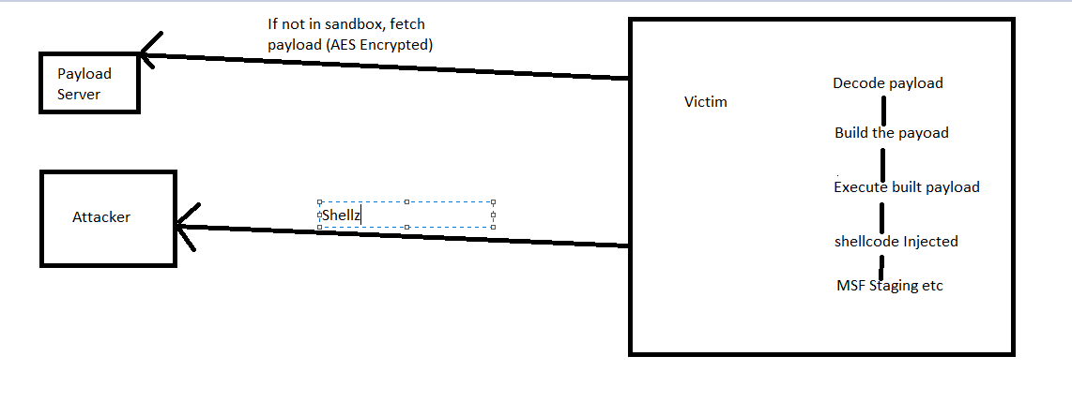
What just happened?

Slide 8
Basics
Written in C# (It’s what I know)
Payloads fetched over network (encrypted)
Stage has to touch disk
Payload does not

Slide 9

Using c# to build c#?

Slide 10
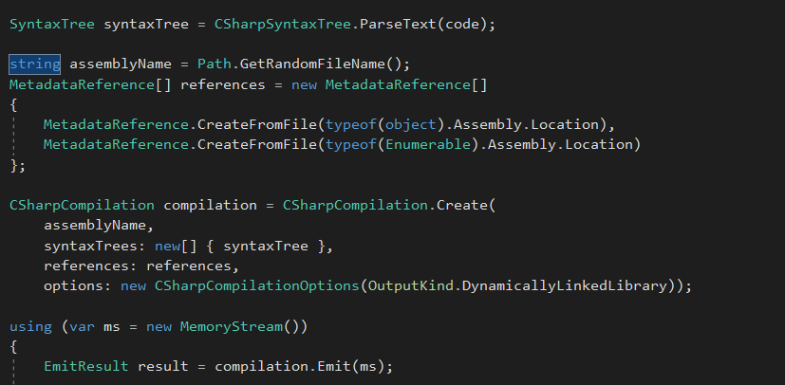
Using c# to build c#
Roslyn:
In memory (payload never touches disk)

Slide 11
Executing the payload
Use reflection to execute the compiled code

Slide 12
Sandbox detection
Uses “Check Please”.
https://github.com/Arvanaghi/CheckPlease
Only simple checks for now (mostly to aid debugging)
Minimum number of USB drives
Minimum number of installed browsers

Slide 13
payloads
Executes arbitrary C# code
32 and 64 bit shell code loader
Modified version of SharpDump
No real limitations on what can be run

Slide 14
Ghostpack/Sharpdump
C# port of PowerSploit Out-Minidump.psq
https://github.com/GhostPack/SharpDump
Ported to work with Inception

Slide 15
Payload builder
Menu-driver python app
Currently supports:
Meterpreter reverse HTTPS shell code
Custom payloads (encrypt only)

Slide 16
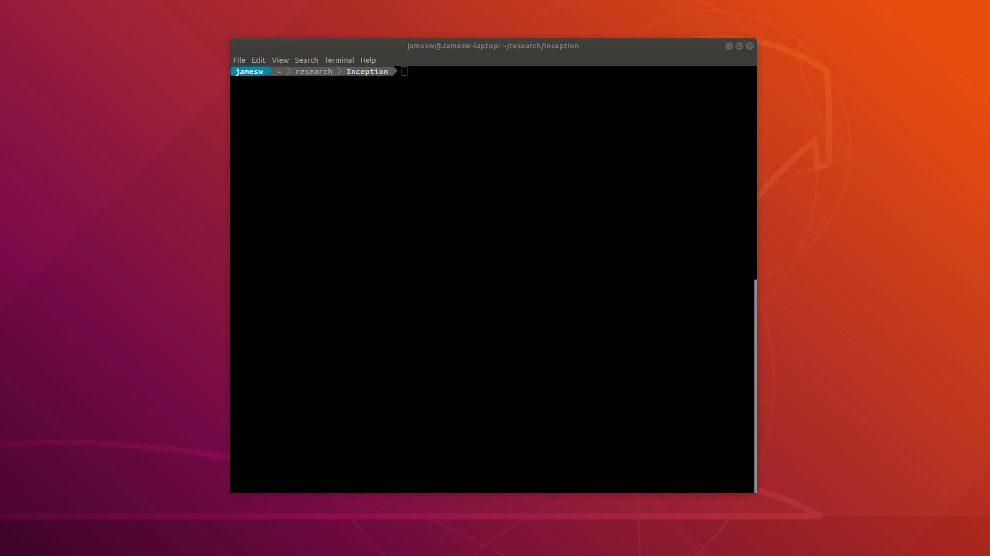

Slide 17
Building shellcode payloads
Generate the Meterpreter shellcode
Write the shellcode into the payload template
AES encrypt the modified template with a random key
Write the files to ~/.inception/payloads and payloads_raw
Use the key as the URL for the payload server

Slide 18
Building custom payloads
AES encrypt the template with a random key
Write the file to ~/.inception/payloads
Use the key as the URL for the payload server

Slide 19
Writing custom payloads
Simple template
Avoid console writes

Slide 20
Payload server
Handles payload download requests
Enforces maximum number of reads per payload
Supports redirects if payload is fetched more than n times
Flask app with sqlite DB

Slide 21
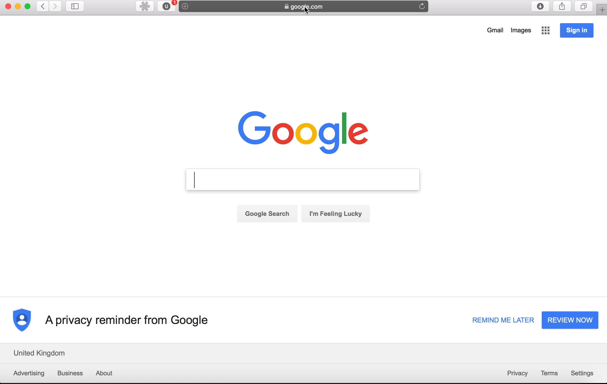

Slide 22
Demo time!

Slide 23
symantec endpoint 14

Slide 24
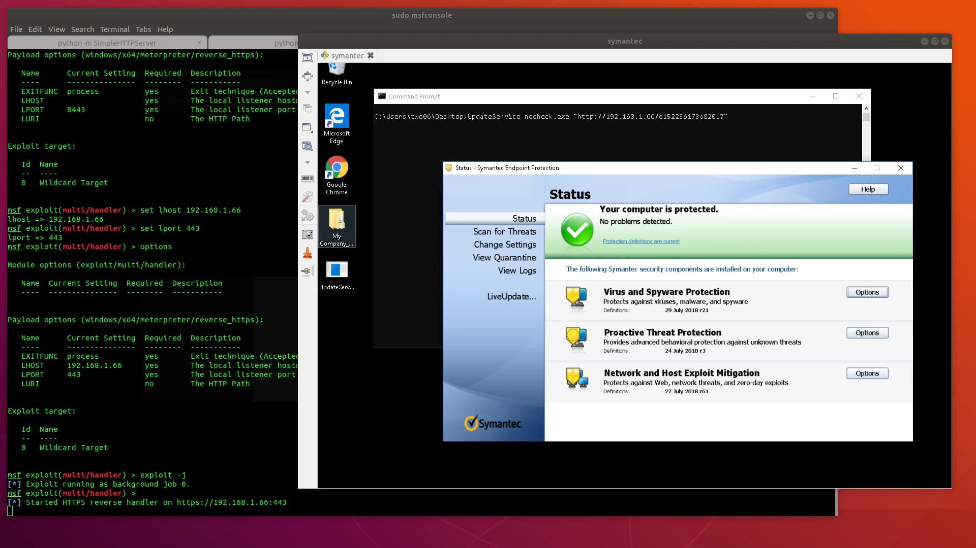

Slide 25
Sophos intercept X

Slide 26
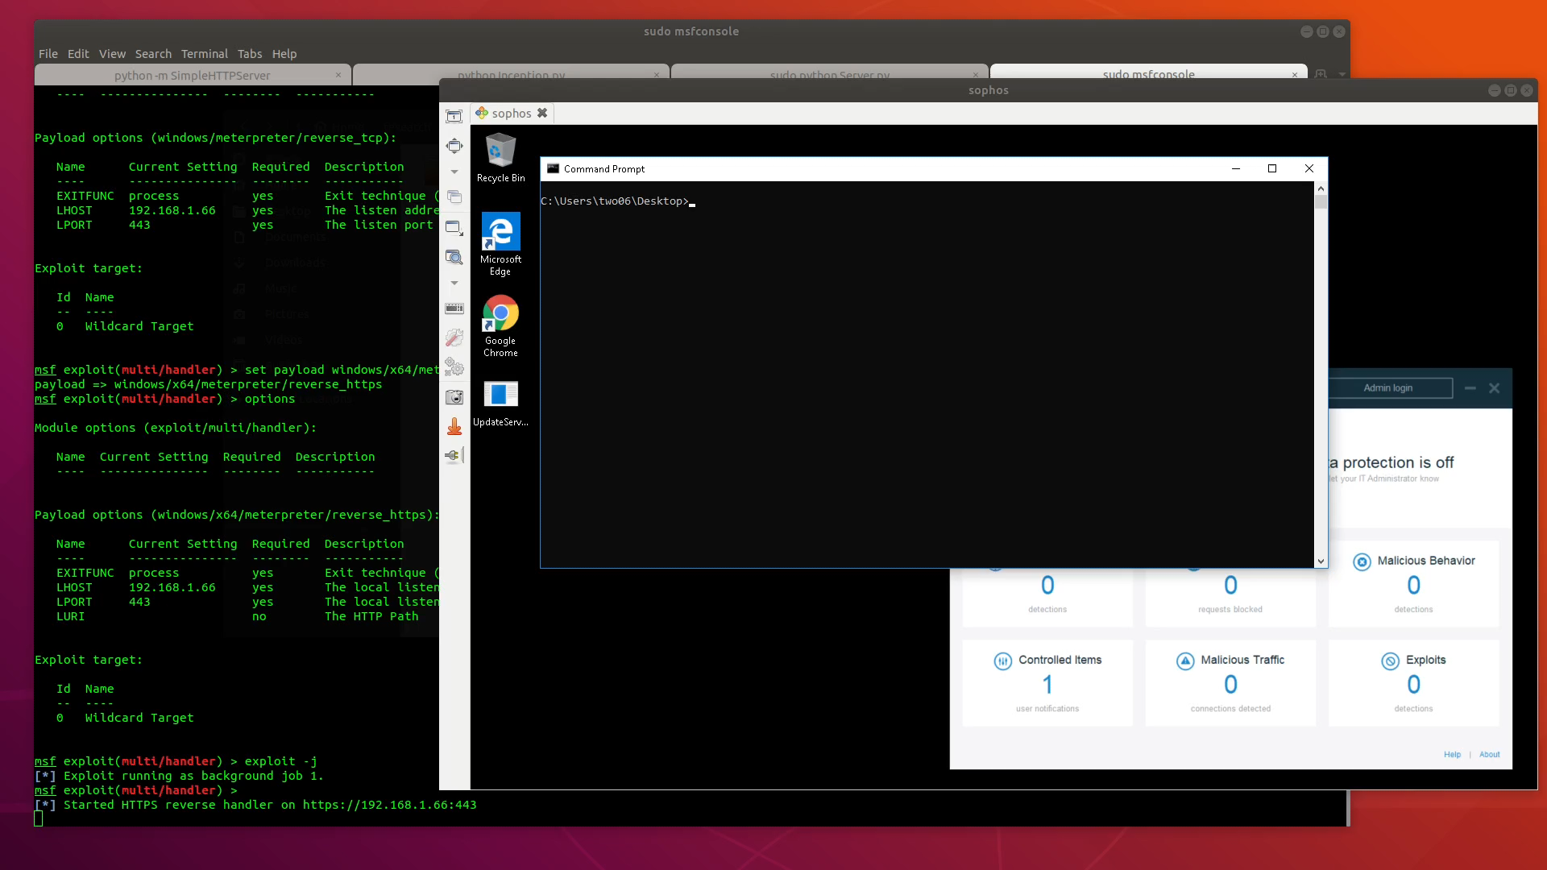

Slide 27
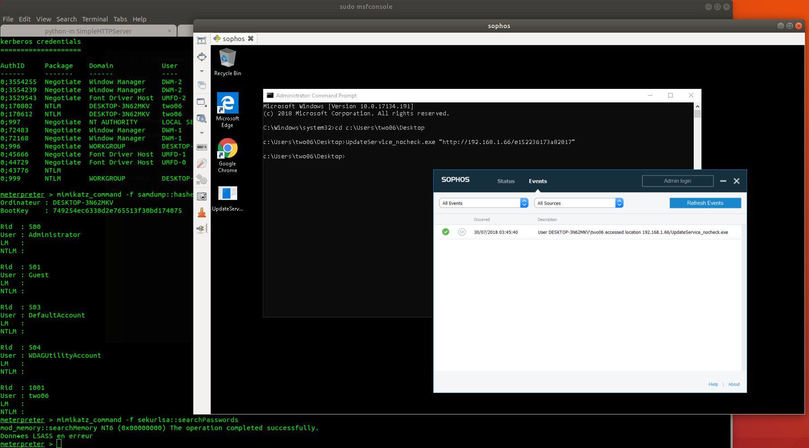

Slide 28
ESET

Slide 29
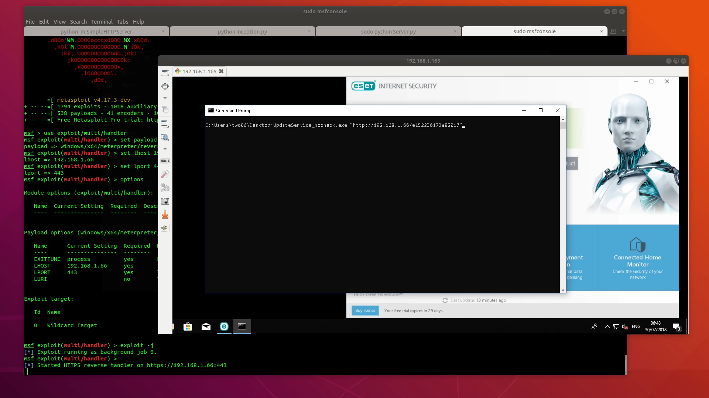

Slide 30
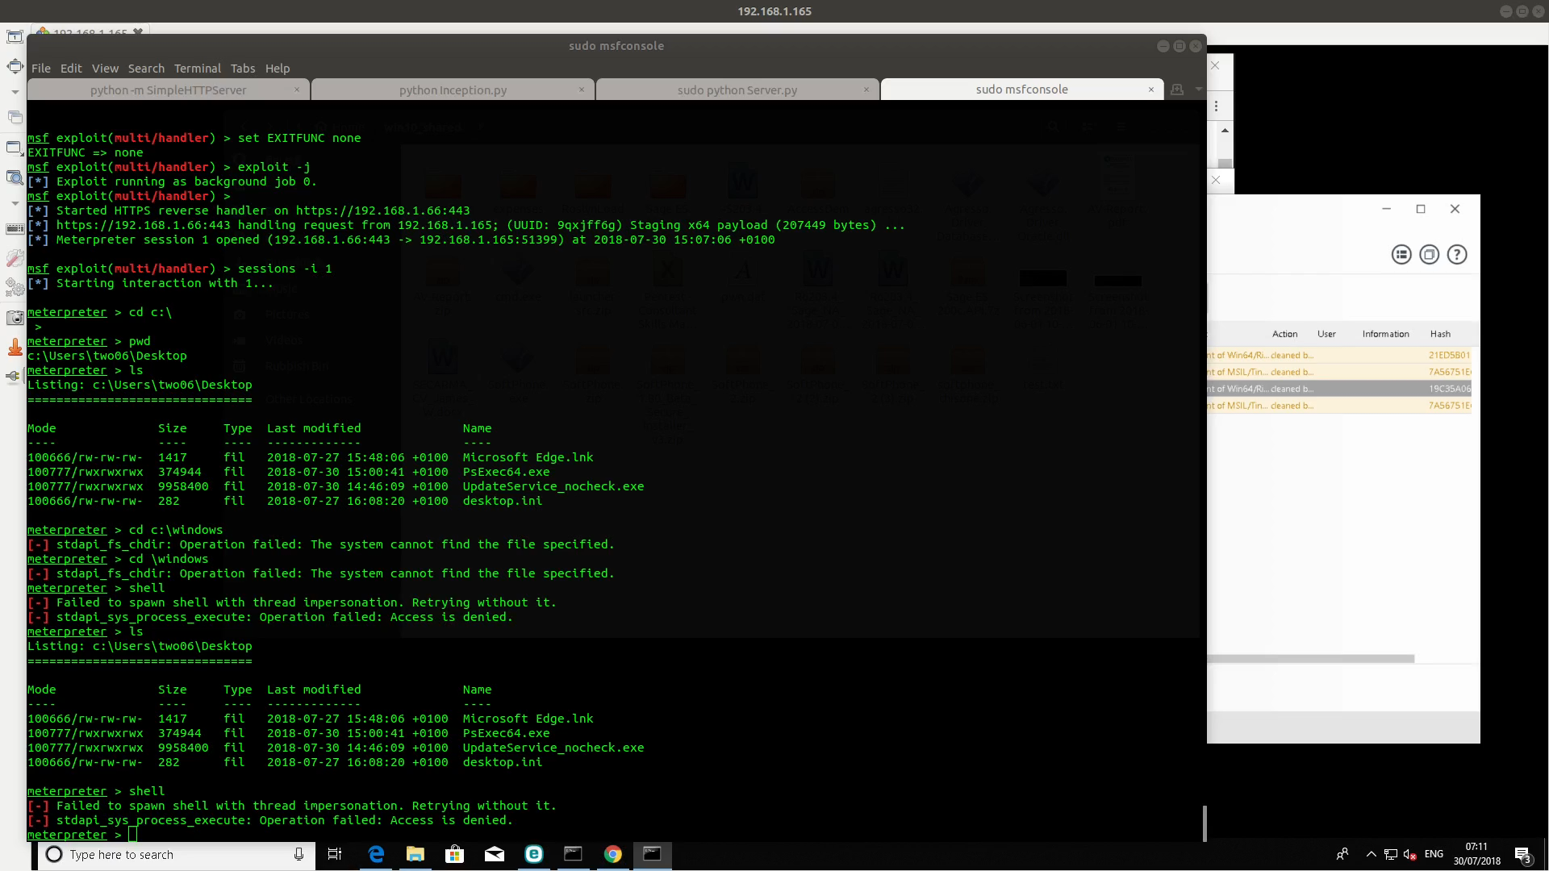

Slide 32
Mcafee adaptive threat protection

Slide 33
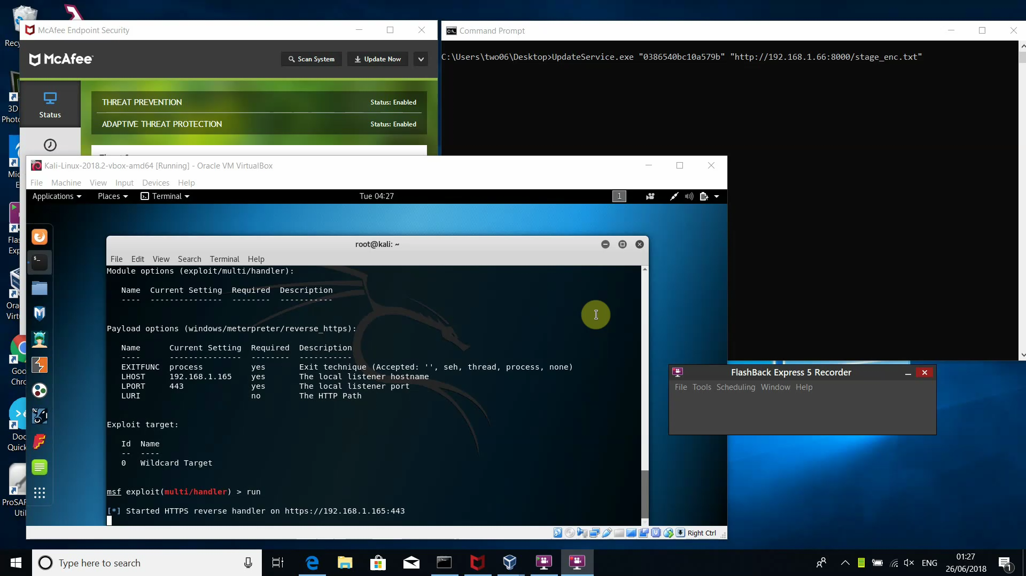

Slide 34
Sentinel one

Slide 35
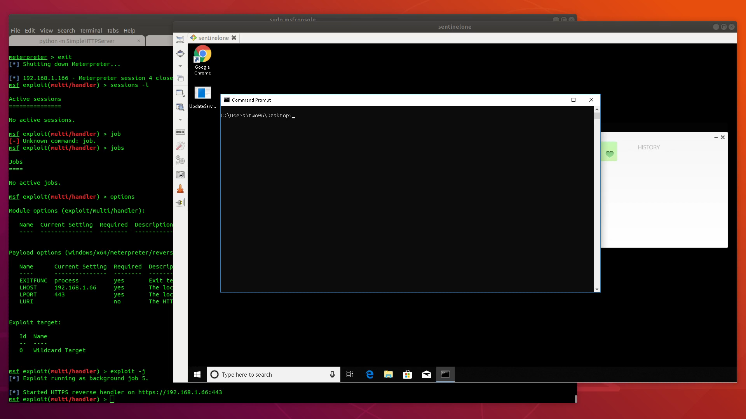

Slide 37
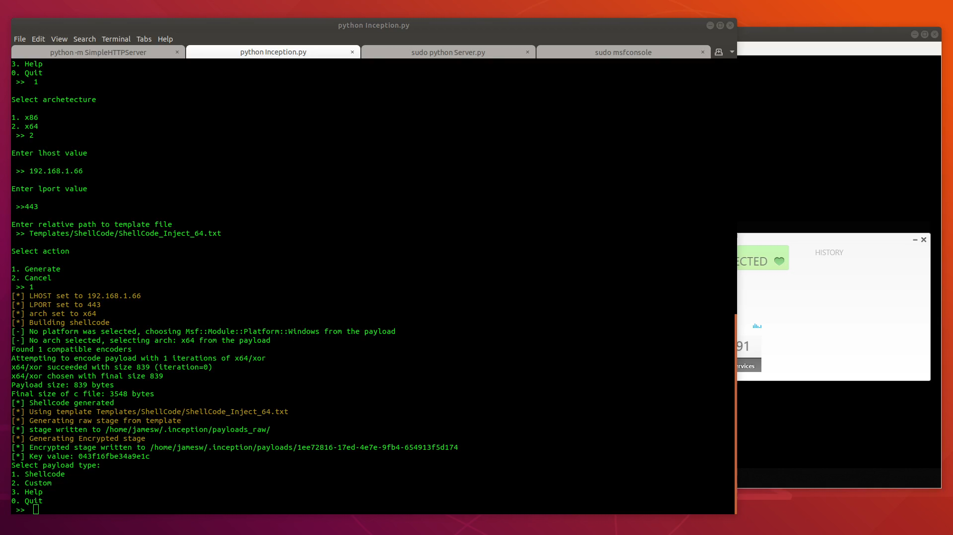

Slide 38
Cylance
Flags on marking memory as executable
Flags on LSASS read
Completely ignores 32 bit…

Slide 39
Further work
Postback support
allows data exfiltration
More templates
More AV engines
Port to other languages…

Slide 40
Java implementation
Written by Paul Ritchie
Presented at Glasgow Defcon
https://github.com/cornpirate/java-stager

Slide 41
How to fix?
This is a post-exploitation tool
Avoid the initial compromise
There will always be AV bypasses…
Alerting on new binaries added to hosts
Monitor network traffic
Don’t rely on AV alone

Slide 42
Tool release
https://github.com/two06/inception

Slide 43
Questions?
Come find me on our stand
Twitter: @two06

